Slide 1
BIGTECHCOMPANY
Financial Overview
By Wambui Gitahi

Slide 2
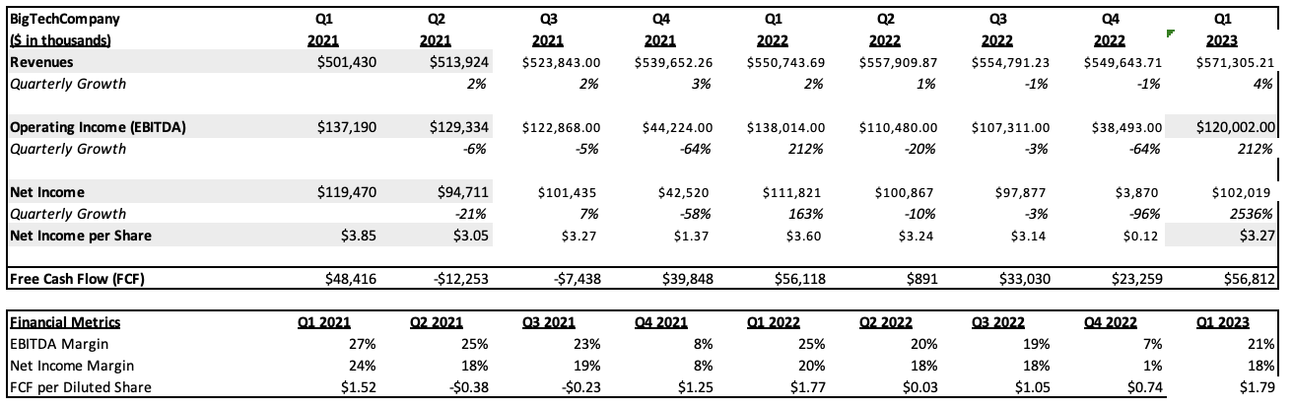
QUARTERLY PERFORMANCE

Slide 3
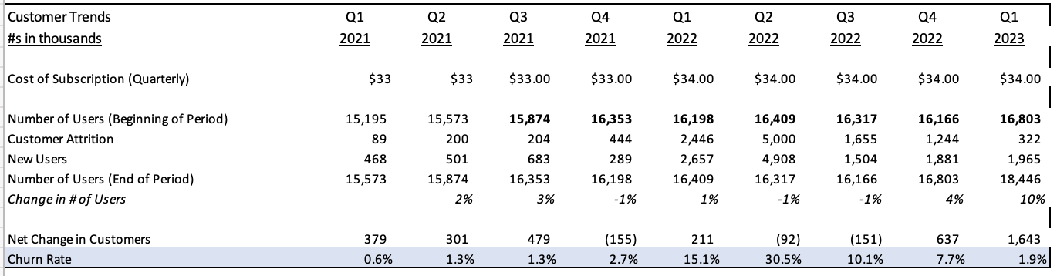
CUSTOMER TRENDS
Key Takeaways:
The increase in price caused an increase in customer attrition. However, a year after the price change, the customer attrition decreased.
The churn rate increased after the increase in price with the highest rate in Q2 2022.
Customer numbers are increasing. The change in users fluctuates, but significantly increased in Q1 2023.

Slide 4
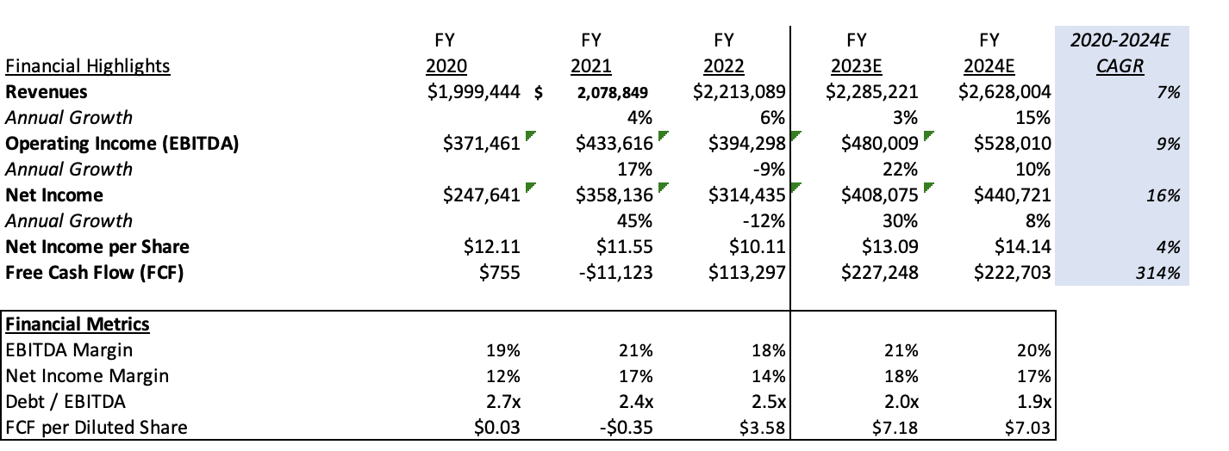
PROJECTIONS

Slide 5
CONCLUSIONS
Company Highlights
The company’s quarterly growth has been fluctuating between 2-3% with a decrease in growth from Q2-Q4 of 2022.
The company’s future quarterly growth is estimated to be 6% in Q2 2023.
The Debt-to-EBITDA ratio is below 3 and decreasing each quarter.
Areas of Concern
EBITDA Margin of >20%, except at the end of Q4 in 2021 and 2022. This is below the industry average of 39%.
Net Income Margin is relatively high, except at the end of Q4 in 2021 and 2022 when it is very low.
Recommendation
We should develop a relationship with Stargaze because the company’s historical data on revenues is relatively consistent and is projected to increase in the future from Q2 2023.
The company also has good Debt-to-EBITDA ratio.
We should ask the company to provide an explanation for the low profits at the end of the final quarter of each year.

